Slide 1

Test station system concept for CFW600
Engenharia Industrial Drives

Slide 2
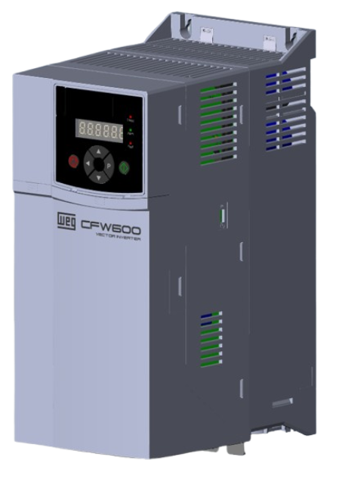
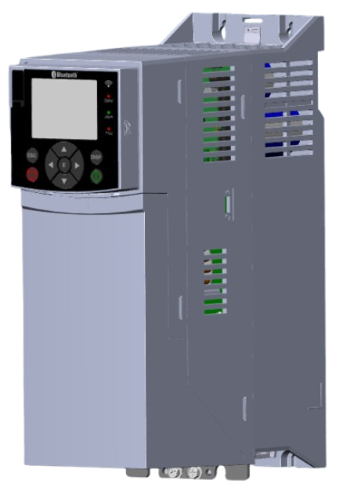
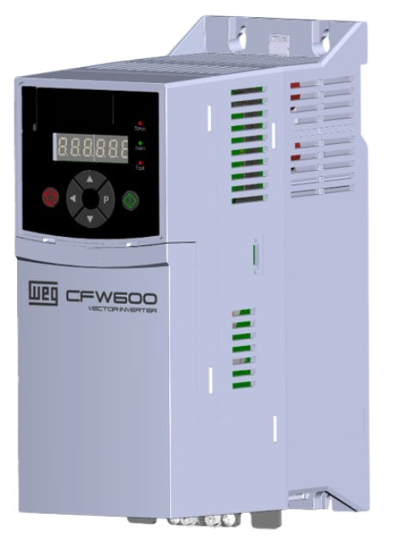

CFW600 A, B, C Test system concept.
- Based on the sales volume of these sizes, and the possibility of producing the same products in other countries, two concepts are proposed
First concept - LIM 2.0: Use the same concept as the existing LIM lines, with improvements
Automated power and control connections;
Automated laser engraving and packaging;
Vision inspection and Mate system during the manual assembly;
6 test positions;
Second concept, fully automated assembly, test, packaging line:
Automated power and control connections;
Automated laser engraving and packaging;
Automated assembly;
6 test positions;
Fully integrated system;

Slide 3
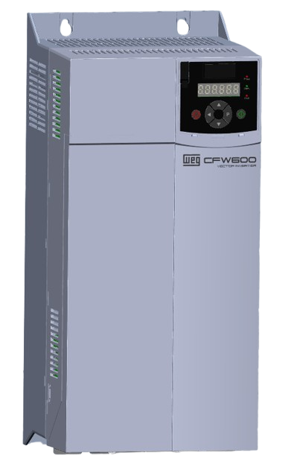
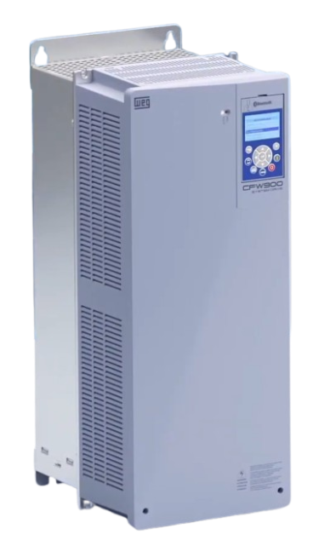
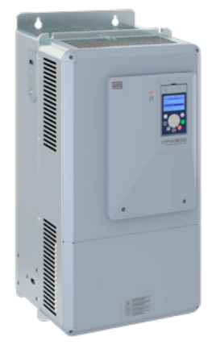
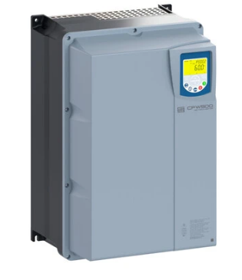
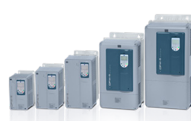
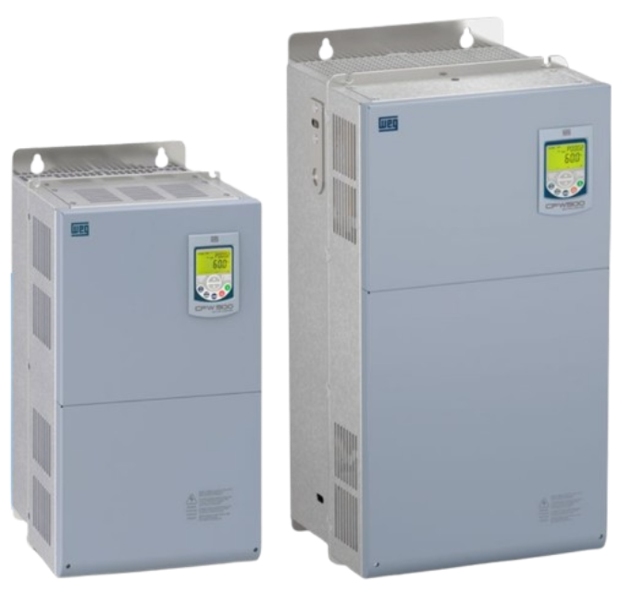
CFW600 D, E, F Test system concept.
Based on the similarity of these sizes with another drives in the catalogue the concept is to integrate more products in one or two test systems.
The first concept consists of a single test system with three test positions to support all products. (CFW600 D, E, F, CFW900 C, D, E, CFW11 A, B, C, D, E, CFW500 C IP66, F, G).
Each position will be prepared to test specific product types, such as terminal or busbars connections, low and high power, and varying sizes and weights.
CFW600 D
CFW500 C IP66
CFW500 F, G
CFW900 D
CFW900 E
CFW11 A, B, C, D, E

Slide 4
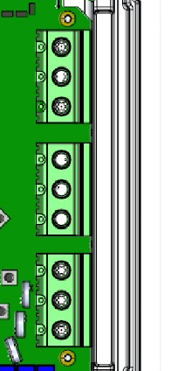
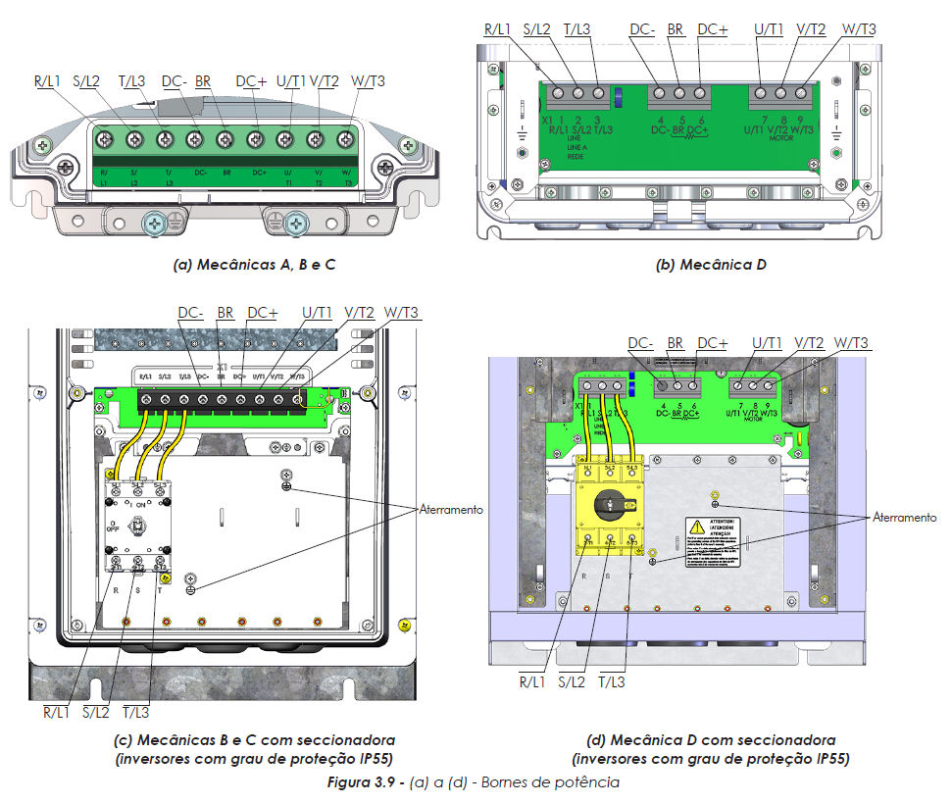
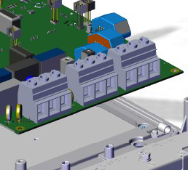
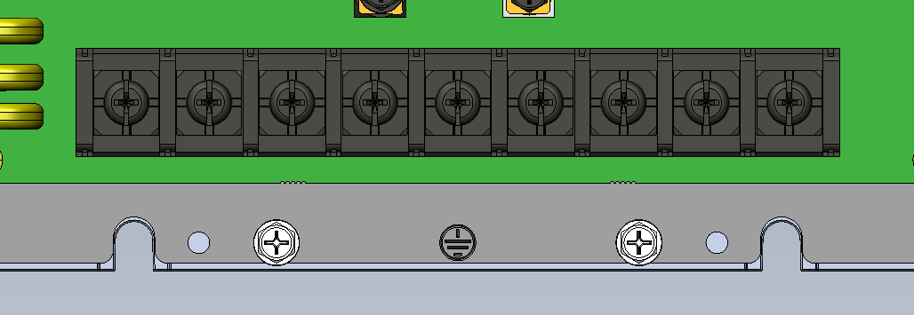
CFW600 D, E Test system concept.
The second concept is two dedicated test systems separated based on product power, size and connections.
1- The low power test system will attend: CFW900 D T6, CFW11 A, B, C, D, CFW500 C IP66, F. All these products use power terminals (bornes) connections.
CFW500/501 F
CFW11 A, B, C, D
CFW600 D, E
CFW900 D T6

Slide 5
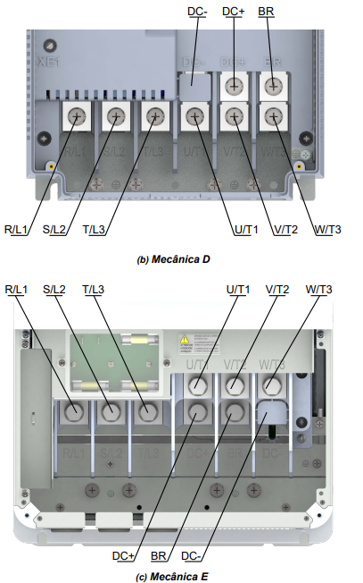
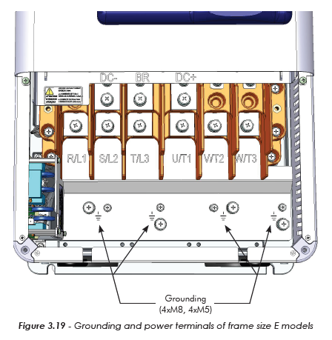
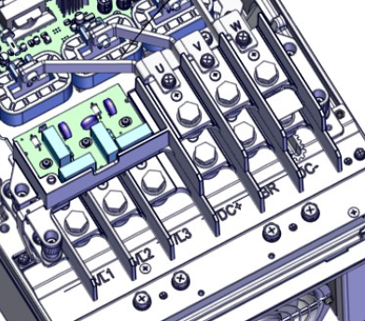
CFW600 D, E Test system concept.
2- The high power test system will attend: CFW600 F, CFW900 D T2/T4, E, CFW11 E, CFW500 G. All these product use busbars for power connection.
CFW11 E
CFW500/501 G
CFW900 D T2/T4, E

